Slide 1
Introduction to Machine Learning Technologies
COMP6246: Machine Learning Technologies (MSc)
Dr Indu Bodala (i.p.bodala@soton.ac.uk)
21 September 2026
Notes:
275723

Slide 2




About Me - My Academic Journey
PhD @ NUS Graduate School of Integrative Sciences and Engineering
Brain-Computer Interfaces
Post-doc @ School of Computing, NUS
Human-robot interaction
Postdoc @ Computer Lab, University of Cambridge
Designing social robots for wellbeing
Lecturer @ University of Southampton
Agents, Interaction and Complexity (AIC) group, Computer Science.
Bachelors in Electrical Engineering @ Indian Institute of Technology Bhubaneswar
Sensors and Signal Processing
Cognitive Neuroscience
Modelling Human factors
Indu Bodala
Module Leader, COMP6246.
Email: i.p.bodala@soton.ac.uk

Slide 3
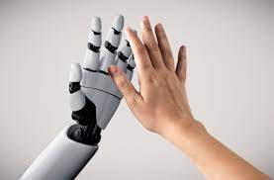
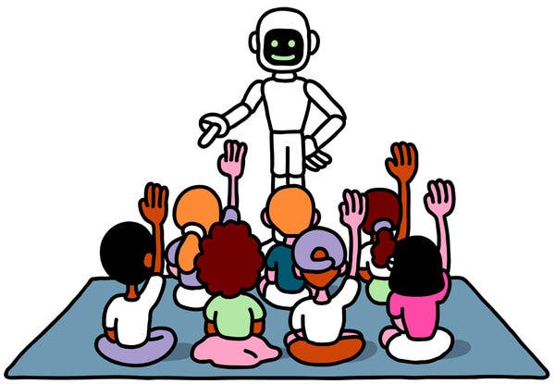
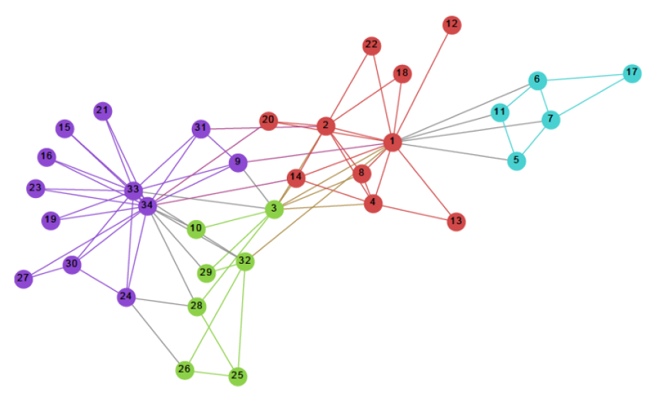
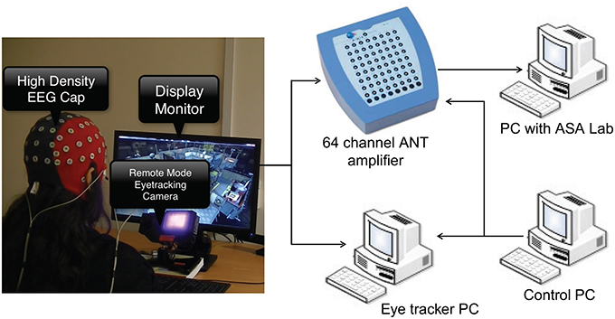
My Research
Human-Robot Interaction (HRI)
Social Assistive Robots (SARs)
AI/ML methodologies
Designing interactions
Human in-the-loop
Robot efficiency vs. user trust
Robots in social scenarios
User perceptions and acceptance
Affective computing
Examples: robots for education; household robots
Health Technologies
Cognitive Neuroscience
Computational models for diagnosis and management
Probabilistic models and graph networks
Adaptive interventions
Brain-computer interfaces
Decoding mental states
Multimodal signal analysis – EEG, Eye tracking. Heart rate.

Slide 4
Lecture Outline
Module Overview
  Why COMP6246?
  Learning Objectives
  Delivery and Assessment
  Resources
Introduction to Machine Learning
  Definitions
  Types of ML systems

Slide 5
Why COMP6246?
Intuitive, practical, hands-on course on Machine Learning
Covers a large number of techniques from the simplest (e.g. linear regression) to the most current (deep learning)
Discusses practical challenges arising when implementing ML algorithms
Case studies – Health, computer vision, etc.
  Use Case Lectures
  Invited Talks
Best Practices and Ethics

Slide 6
Learning Outcomes
A1 | The algorithmic basis of machine learning algorithms
A2 | Implementation issues in learning algorithms and the evaluation of their performance.
B1 | Characterise data in terms of explanatory models
B2 | Critically appraise the uses of machine learning techniques
B3 | Appreciation of the landscape of tools used for modern machine learning
D1 | Systematically work with data to learn new patterns or concepts
D2 | Gain expertise in working with machine learning to make predictions in a scientific computing environment

Slide 7



Teaching Team
Dr Indu Bodala
(module leader;
I.P.Bodala@soton.ac.uk)
Human-Robot Interaction
ML for Health
Cognitive Neuroscience
Dr Mohammad Soorati
(M.Soorati@soton.ac.uk)
Multi Robot Systems
Human-Swarm interactions
Explainable and Trustworthy AI
Dr Daniela Mihai
(A-D.Mihai@soton.ac.uk)
Representation Learning
Multi-agent communication
Emergent communication

Slide 8
Module Delivery
Lectures – In-person; schedule on Blackboard
  Theory Lectures: Week 1 to Week 5
  Practical Lectures and Coursework Surgeries: Week 6 to Week 10
  Exam Support Session: Week 12
Labs – Weeks 1-7; Friday, 4-6 pm; Computing Lab.
Textbook – Aurélien Géron - Hands-On Machine Learning with Scikit-Learn & TensorFlow
Mathematical prerequisites - Some helpful resources from the textbook
    https://github.com/ageron/handson-ml/blob/master/math_linear_algebra.ipynb
    https://github.com/ageron/handson-ml/blob/master/math_differential_calculus.ipynb
*Weeks are semester weeks

Slide 9
Resources
Slides/notes for lectures and labs are available before each session on Moodle
Coursework will be published in Week 4
Pay attention to Announcements on Moodle re. lecture schedule, coursework submission links, etc.
Lectures are in-person. Recordings are available later, but may not capture all classroom discussions
Exam support sessions and coursework surgeries are scheduled for assessment support
Email responses may not be immediate but may take 1-2 working days; please make use of the contact hours, i.e. lectures/labs.

Slide 10
Assessment
Exam – 50%
  Topics from theory lectures
  Content from coursework use-case lectures and guest lectures not included
Coursework – 50%
  ML development and analysis on a dataset
  Deadline in week 11
  Coursework description released in week 4

Slide 11
Introduction to Machine Learning
The science (and art) of programming computers so that they can learn from data.​
When is ML useful?
  Problems that are difficult to solve with traditional programming - existing solutions require a lot of manual tuning or long lists of rules
  Fluctuating environments - to predict or classify new data
  Getting insights about complex problems and large amounts of data (data mining, data science).
  Efficient, real-time data processing
Real life examples of ML systems
  Spam filter on your email
  Face recognition on your phone

Slide 12
Types of ML Systems
Data
  Supervised
  Unsupervised
  Semi-supervised
  Reinforcement Learning
Offline (Batch) vs Online learning
Instance vs Model-based Learning
Discriminative vs Generative

Slide 13




Supervised Learning
Input X
Output Y
Supervised learning: Given input X, predict output Y
Training set: a set of examples with correct input-output pairs
Labelled data: input data with its correct output labels
Input data:
labels:
“monkey”
“cat”
“dog”

Slide 14
Supervised Learning – Algorithms
Supervised Learning Tasks
  Classification
  Regression
Algorithms
  k-Nearest Neighbors
  Linear Regression
  Logistic Regression
  Support Vector Machines
  Decision Trees and Random Forests
  Neural Networks

Slide 15

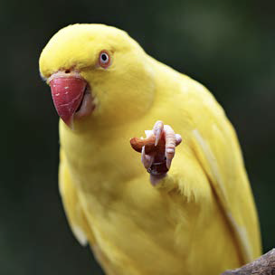


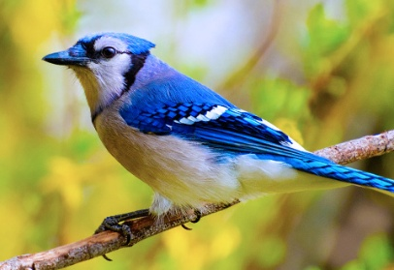


Unsupervised Learning
What happens when there are no labels?
Unsupervised Learning discovers patterns, structures or groupings in the data

Slide 16
Unsupervised Learning – Algorithms
Clustering
  k-Means
  Hierarchical Cluster Analysis (HCA)
Anomaly and Novelty Detection
  One-class SVM
  Isolation Forests
Visualisation and Dimensionality Reduction
  PCA; Kernel PCA
  Locally Linear Embedding

Slide 17
Semi-supervised and Reinforcement Learning
Semi-Supervised Learning
  Labelled data is expensive and difficult to find
  Semi-supervised algorithms work with partially labelled data
  Combination of supervised and unsupervised learning techniques
Reinforcement Learning
  An agent selects and performs an action
  Gets rewards
  Learns the best strategy (policy) to maximise reward over time.

Slide 18
Types of ML Systems
Data
  Supervised
  Unsupervised
  Semi-supervised
  Reinforcement Learning
Offline (Batch) vs Online learning
Instance vs Model-based Learning
Discriminative vs Generative

Slide 19
Offline (Batch) vs Online Learning
Offline (Batch) Learning
  The system is trained on all the available data and then launched to run without training anymore
  To learn new data, the system has to be retrained on the full dataset (old and new data points)
  Incapable of learning incrementally
Online Learning
  System trains incrementally on individual data points or mini-batches of data
  Can forget old data if the learning rate is high; can resist new data or non-representative outliers if the learning rate is low
  Performance can decline over time if bad data is fed

Slide 20
Types of ML Systems
Data
  Supervised
  Unsupervised
  Semi-supervised
  Reinforcement Learning
Offline (Batch) vs Online learning
Instance vs Model-based Learning
Discriminative vs Generative

Slide 21
Instance-based Learning
Training instances are stored and used directly to make predictions.
No explicit generalisation or model is built during training
New data is compared to the learned examples – using a similarity score
A new instance, based on the similarity score, would be classified into a class if the majority of ’similar’ examples belong to that class
Examples
  k-Nearest Neighbours

Slide 22
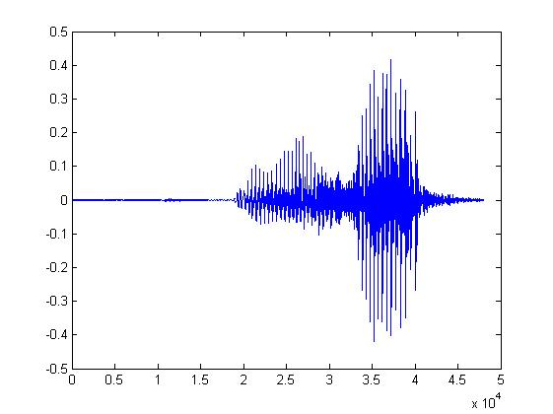
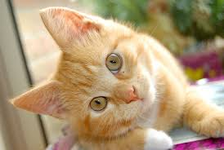

Model-based Learning
Machine Learning ≈ Looking for a Function
Speech Recognition
Image Recognition
Playing Go
“How are you?”
“Cat”
“5-5” (next move)

Slide 23
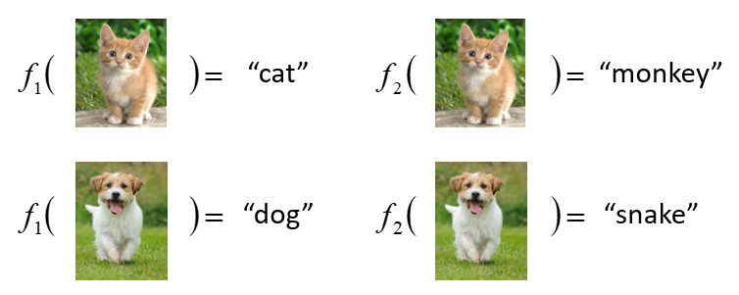
ML framework
Image Recognition:
“cat”
A set of functions
Model
Better!
Goodness of function f
Training
Data
function input:
function output:
“monkey”
“cat”
“dog”

Slide 24
ML framework
Image Recognition:
“cat”
A set of functions
Model
Training
Testing
“cat”
Step 1
Goodness of function f
Train to obtain the “Best” Function
Using
Step 2
Step 3
Training
Data
“monkey”
“cat”
“dog”

Slide 25
Types of ML Systems
Data
  Supervised
  Unsupervised
  Semi-supervised
  Reinforcement Learning
Offline (Batch) vs Online learning
Instance vs Model-based Learning
Discriminative vs Generative

Slide 26
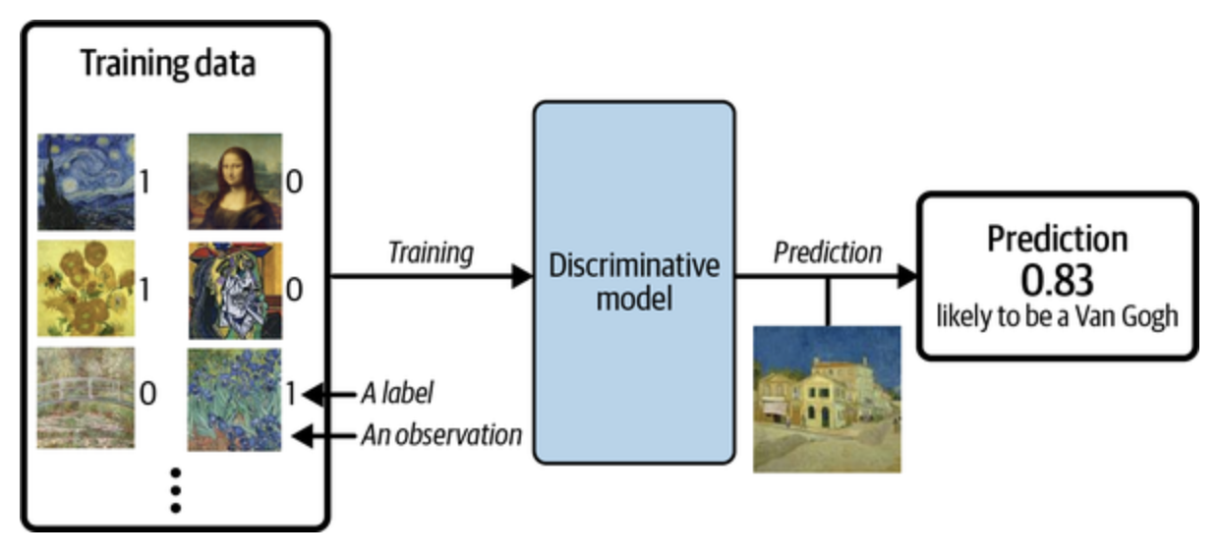
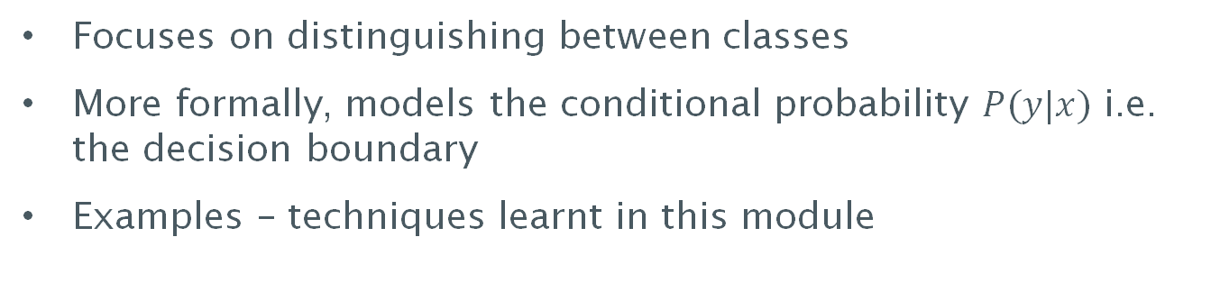
Discriminative Modeling
Figure adapted from Foster, D. (2022). Generative deep learning. O'Reilly Media, Inc.
Focuses on distinguishing between classes
More formally, models the conditional probability $P(y|x)$ i.e. the decision boundary
Examples – techniques learnt in this module

Slide 27
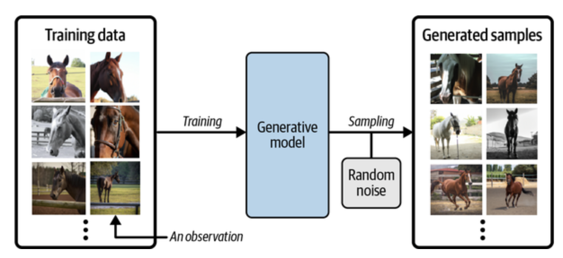
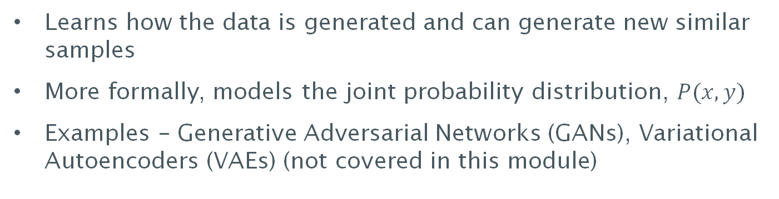
Generative Modeling
Figure adapted from Foster, D. (2022). Generative deep learning. O'Reilly Media, Inc.
Learns how the data is generated and can generate new similar samples
More formally, models the joint probability distribution, $P(x,y)$
Examples – Generative Adversarial Networks (GANs), Variational Autoencoders (VAEs) (not covered in this module)

Slide 28
Summary
In this lecture, we discussed
  Module overview – delivery and assessment
  Machine Learning definitions
  Types of ML systems
    Supervised, unsupervised, semi-supervised and RL
    Batch vs Online Learning
    Instance-based vs Model-based
    Discriminative vs Generative
Reading – Chapter 1 from the textbook

Slide 29
Next Lecture: Developing an ML project – Checklist and Challenges
Tuesday, 22 Sep, 11-12 @ 46/2003

